Slide 1
Fantasy Basketball Draft Kit
By Robert Cheer

Slide 2
What is Fantasy Basketball?
Fantasy basketball is a game where you draft real NBA players and aggregate their statistics. In head to head leagues, you compare your teams aggregated stats to your opponent for a weeks worth of games generally in 9 categories, and each category you win you receive a win and each category you lose you receive a loss.

Slide 3
Creating a Ranking System
The first step of the process was to create a ranking system. Each of the top 200 players by season. Each player was ranked on each category by the amount of standard deviations above the mean. Here were the top 5 players in 2017, you may be surprised that there is no Lebron James or Russell Westbrook on the list.
1) Anthony Davis 2) Steph Curry 3) James Harden 4) Kevin Durant 5) Karl Towns

Slide 4
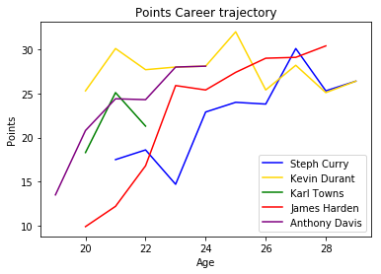
Feature Importance: What Impacts Performance?
If a players team has no personell changes, you can relatively accurately predict next season by just looking at the career trajectory and age of a player.
In the 90s and 2000s, big name players didn’t change teams very much, so you could come up with a relatively accurate prediction for next year just using last seasons stats:
But how do you predict changes such as James Harden going from 10 points to 25 in just two seasons. Steph Curry going from 15 to 23 points in his age 24 season. What are the common threads?
From historical data we know that Harden changed teams, going from a team with established stars Kevin Durant and Russell Westbrook to a Houston team where he would be the main guy. Steph Curry at age 24 saw Monta Ellis traded away, giving him the keys to be the primary ball handler.

Slide 5
Feature Importance: The Star of the Show
In basketball, there are only 5 players on a court and one ball, so one player can impact the others on the court dramatically. In the NBA in particular, one player generally calls the play and determines how a play is going to be run. Adding or losing a star can have dramatic impact to your production
A prime example of that is the rise of Russell Westbrook following the departure of Kevin Durant
Anthony Davis finished first among the fantasy basketball ranks last season following the injury to Demarcus Cousins

Slide 6
What happens when you leave to a team with already established stars?
Going onto a team and switching from being the primary player to a secondary or even third option can really hurt your production.
Kevin Love went from the primary option in Minnesota to a stretch 4 shooter on Cleveland
Kevin Durant left a team with Westbrook but joined Steph Curry and his production was left unchanged

Slide 7
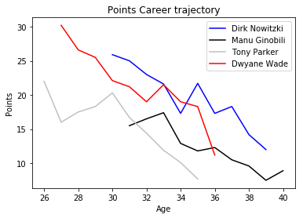
Features: Evaluating Non-Linear Inputs
From slide 6, we saw that those star players still in the prime of their career have tended to get better as they get older. However, when we look at older stars, we actually see the opposite:
We can interpret this deviation as a non linear trend. Players career primes are generally in their upper 20s (25-30), varying slightly by player. Because of this we need to incorporate not just age as a variable but age squared.

Slide 8
Error Testing: Cross Validation and Model Selection
Tests were run using data starting from the 2008-09 season up until the 2016-17 season (may add more data). Cross validated using k-fold cross validation ran grid searches on gradient boosting while also testing Linear Regression and Rectified Linear Unit Neural Networks.
Error Rates were tested against a baseline of choosing last seasons average.
Linear Regression model was selected based on the lowest error on the test sets.
Best models for each category were run on 2017-18 data.

Slide 9
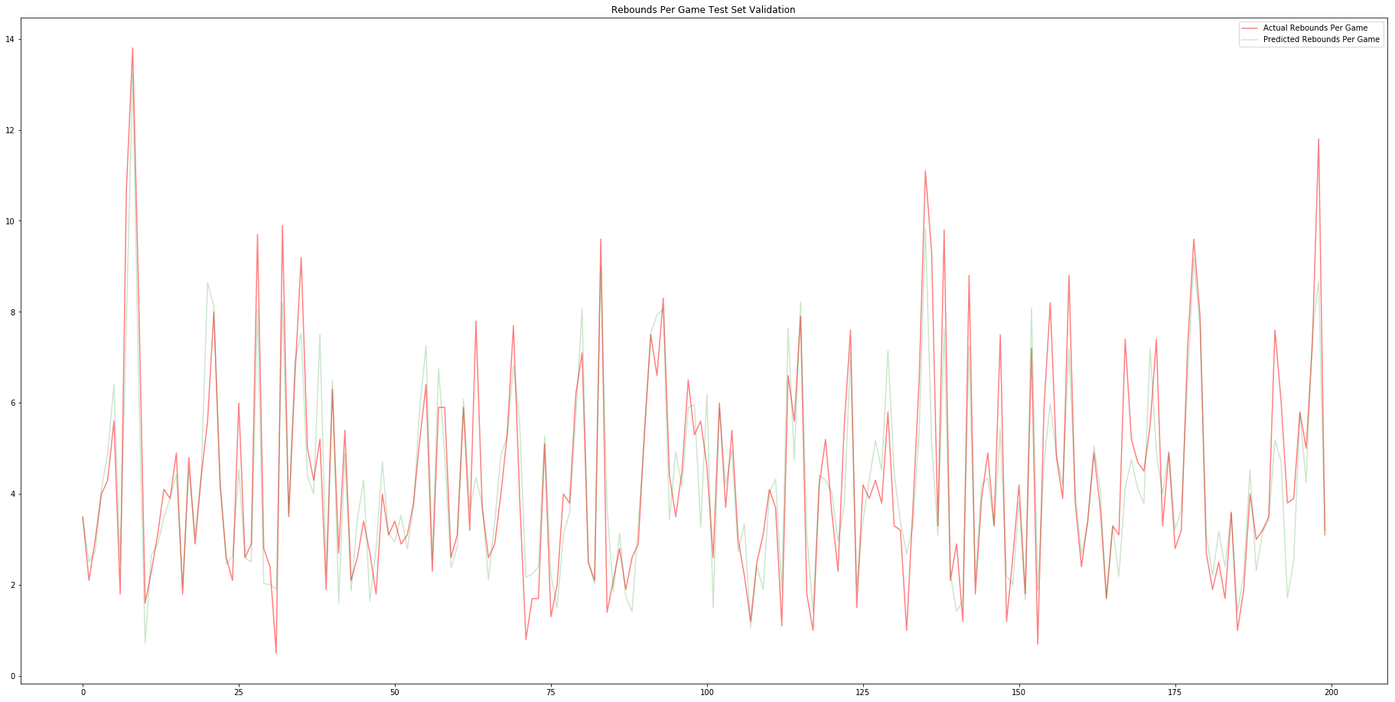

Slide 10
Results: Comparing to Yahoo Rankings
After selecting the final model, loaded in Yahoos preseason rankings from 2017-18 season.
Created rankings based on my predicted model
Compared my rankings as well as yahoos rankings to the actual rankings using Rank Bias Overlap. My model outperformed all Yahoo Experts at each level of the top n sample players.

Slide 11
Predicting Next Season
With the departure of Demarcus Cousins, Anthony Davis is projected to retain his number 1 spot.
Gordon Hayward is expected to fall the most coming off an injury and joining a stacked Celtics team with young guys that could challenge him for playing time
Meanwhile, Buddy Hield and Pascal Siakam who both gained starting spots on teams without ball dominant players are expected to rise the most.

Slide 12
Flask App

Slide 13
Next Steps
1) Get more data for rookies and Olympic team players. These are two points of variance that my data doesn’t explain.
2) I would like to create a class where you could compare your team to other teams and see what categories you can potentially win, which could help more advanced players
3) Trade Evaluator, look at potential trades, whether or not they are fair and how they could potentially benefit both sides.
4) Injury prediction, my model was thrown off when major players were hurt impacting their performance and that of their teammates.

Slide 14
Thank You!

